Slide 1
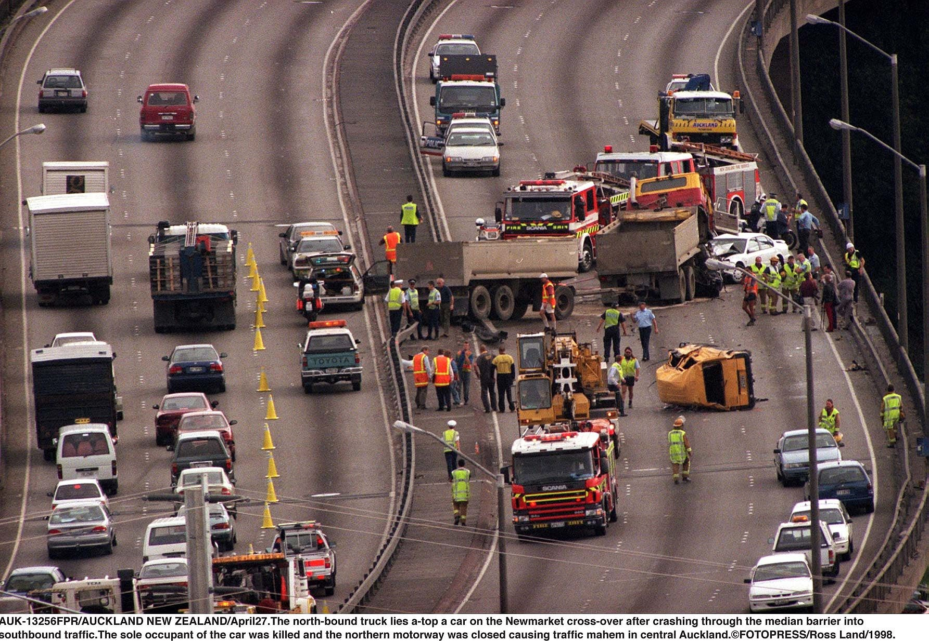
Analysis of US Road Accidents
Group 0
Presented By: Stiles, Shriya, Shivangi, Vedant
Shivangi Gupta | Shriya Tarun | Stiles Clements | Vedant Mehrotra. Group 0

Slide 2
Overview of Issue
From the year 2016-2023 there have been over 7 million documented road accidents in the US. Road traffic accidents remain a critical public safety and economic challenge in the United States
The ability to accurately predict accident severity and identify high-risk locations and time periods holds substantial value for public agencies, policymakers, and urban planners.
2022
Deaths: 44,000
Cost: $470 billion
2023
Deaths: 41,000
Cost: $340 billion
Notes:
To begin, let's talk about the gravity of road accidents in the United States. From 2016 to 2023, there have been over 7 million documented road accidents nationwide. This isn't just a matter of statistics—road traffic accidents present a major public safety threat and an enormous economic burden on our society. In 2022 alone, these incidents resulted in 44,000 deaths and a staggering $470 billion in costs. Even as we move forward, the numbers remain alarming, with 41,000 deaths and $340 billion in damages reported for 2023. Addressing this issue isn't just a policy challenge, it's a call to action for every agency, planner, and citizen. Our goal today is to discuss how better prediction and targeted interventions can help reduce these tragedies and their costs.”
Costs cover lost productivity, medical care, property damage, and more. Beyond the numbers, these represent profound human and economic losses that demand urgent action."

Slide 3

Dataset Overview
Dataset Source: US Accidents Dataset from Kaggle
Size: Sample of 500k
Feature Category | Features
Time Features | Start Time, End Time
Location Features | State, City, County, Zip Code, Street, Longitude, Latitude
Weather Features | Precipitation, Wind Speed, Humidity, Visibility
Road Features | Bump, Crossing, Give Way, Junction, No Exit, Traffic Signal
Notes:
To tackle these challenges, we relied on a comprehensive source: the US Accidents Dataset from Kaggle. Our sample—500,000 records—captures a wide range of time, location, weather, and road features. This means our analysis doesn't just look at when and where accidents happen, but also dives into why: considering factors like precipitation, visibility, and the presence of bump or traffic signal data. This rich dataset empowers us to move beyond surface-level statistics and explore the patterns hiding in plain sight, laying the groundwork for smarter, data-driven safety solutions.”

Slide 4

Exploratory Data Analysis
“spoofygoofy.xyz”

Slide 5



Preprocessing
Date time conversion extracting Monday, Hour, Day of Week
Conversion of Twilight Zones to Ordinal Light Levels
Encoding of Categorical Variables - especially the road features

Slide 6
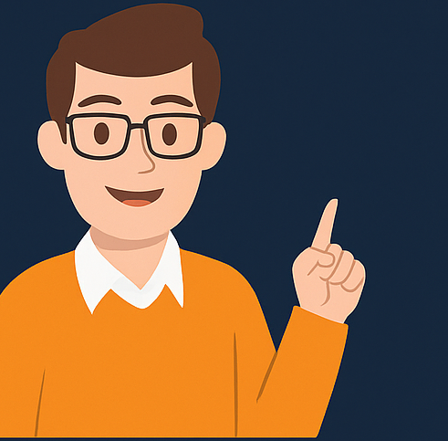
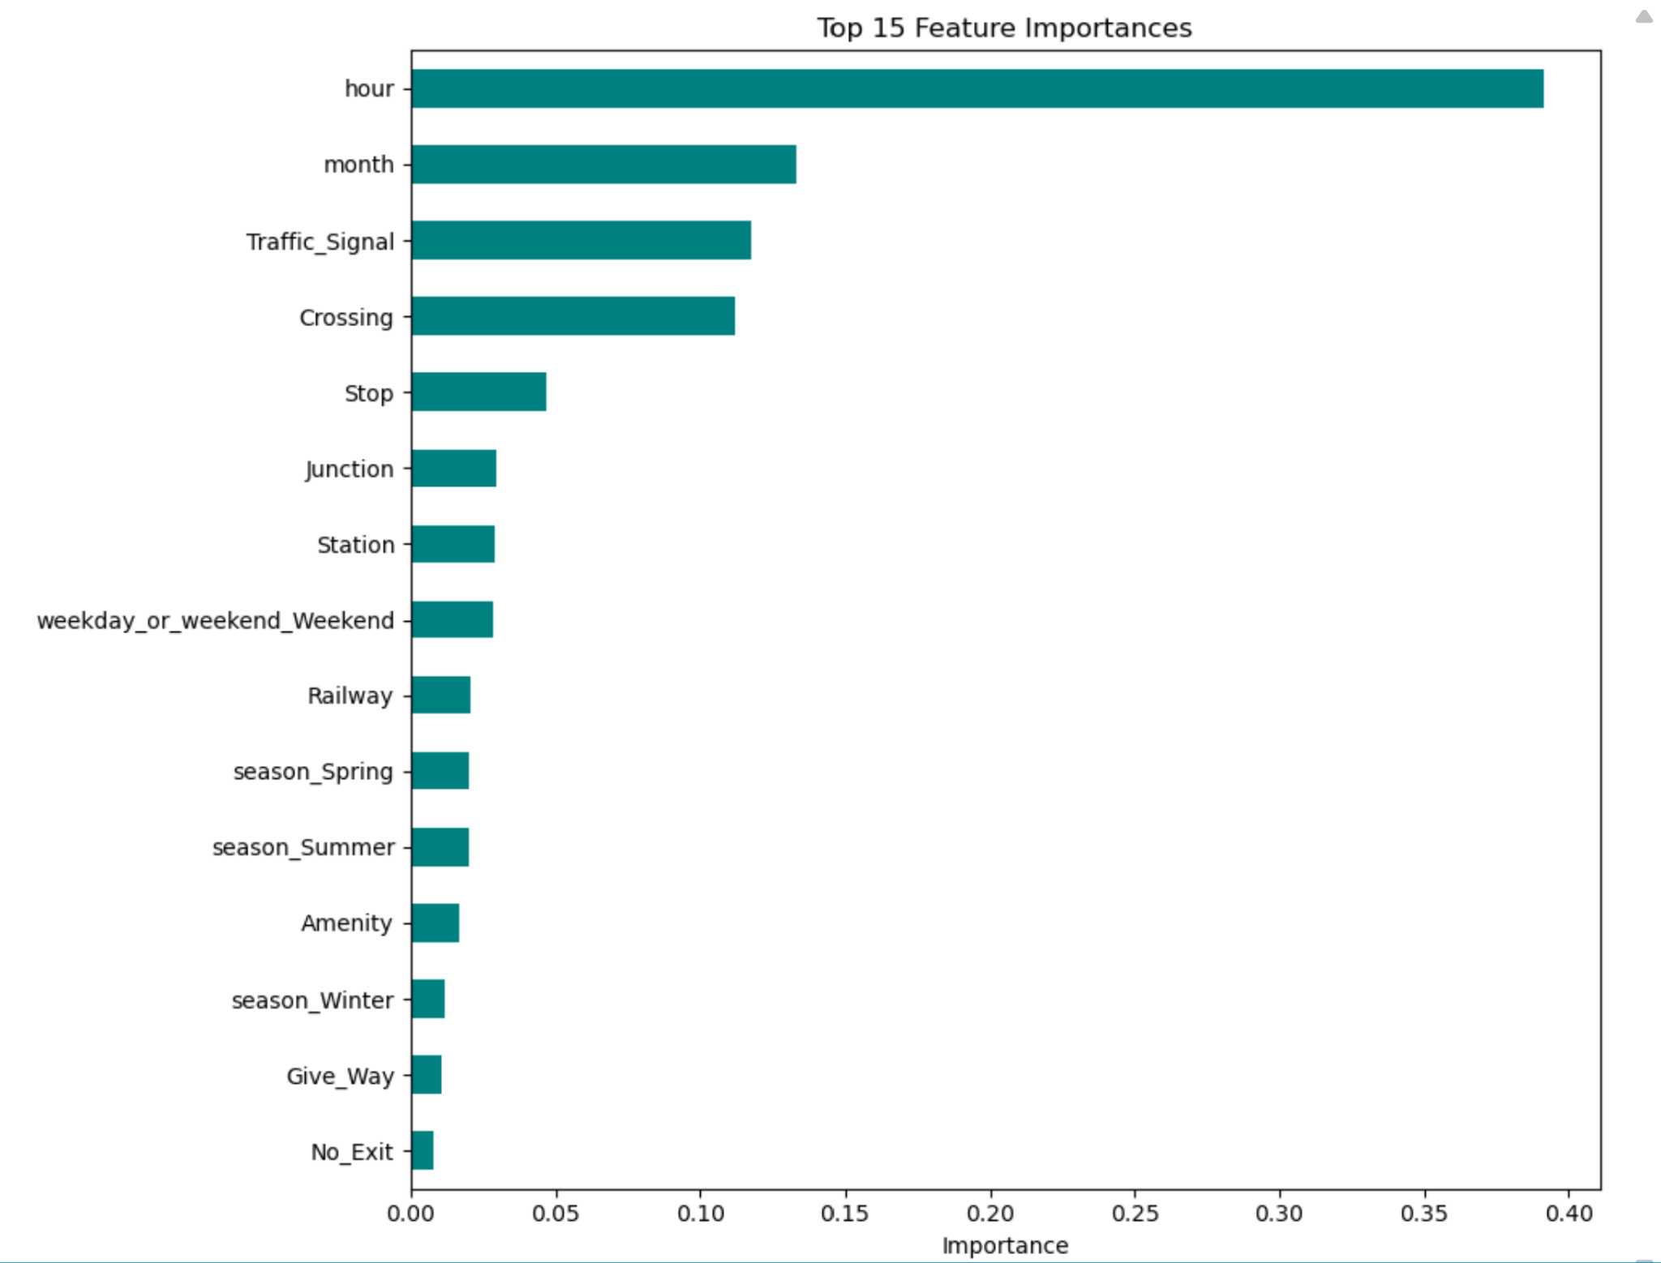
Feature Importance Analysis

Slide 7
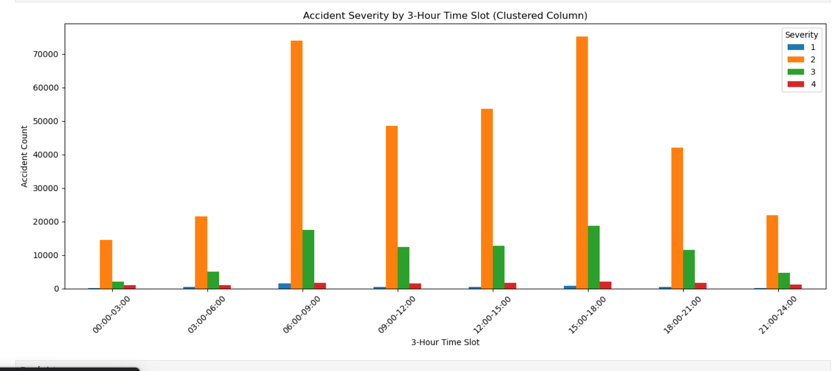
Accident Severity Across 3-Hour Intervals

Slide 8
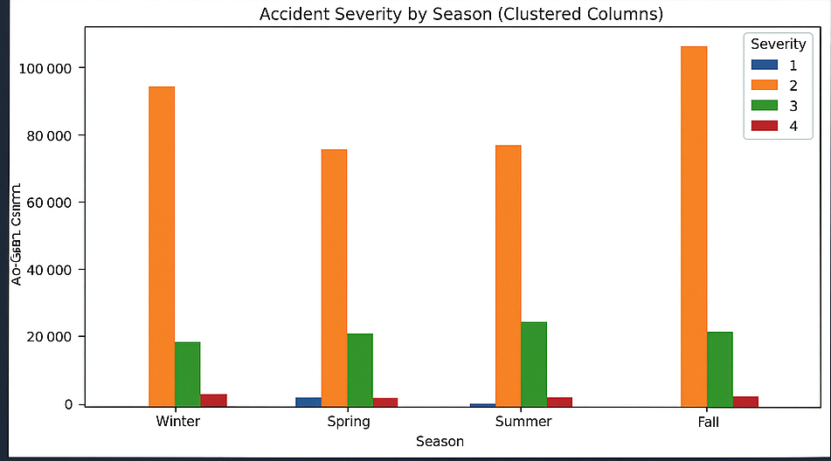
Accident Severity Across Seasons

Slide 9
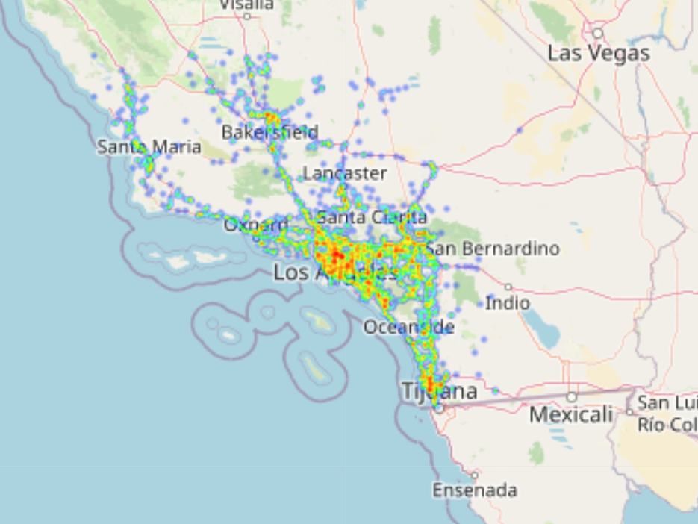
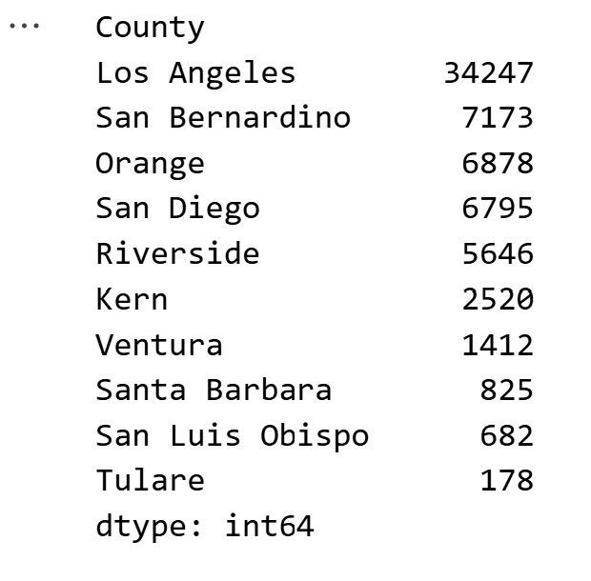
Drill down (County)

Slide 10
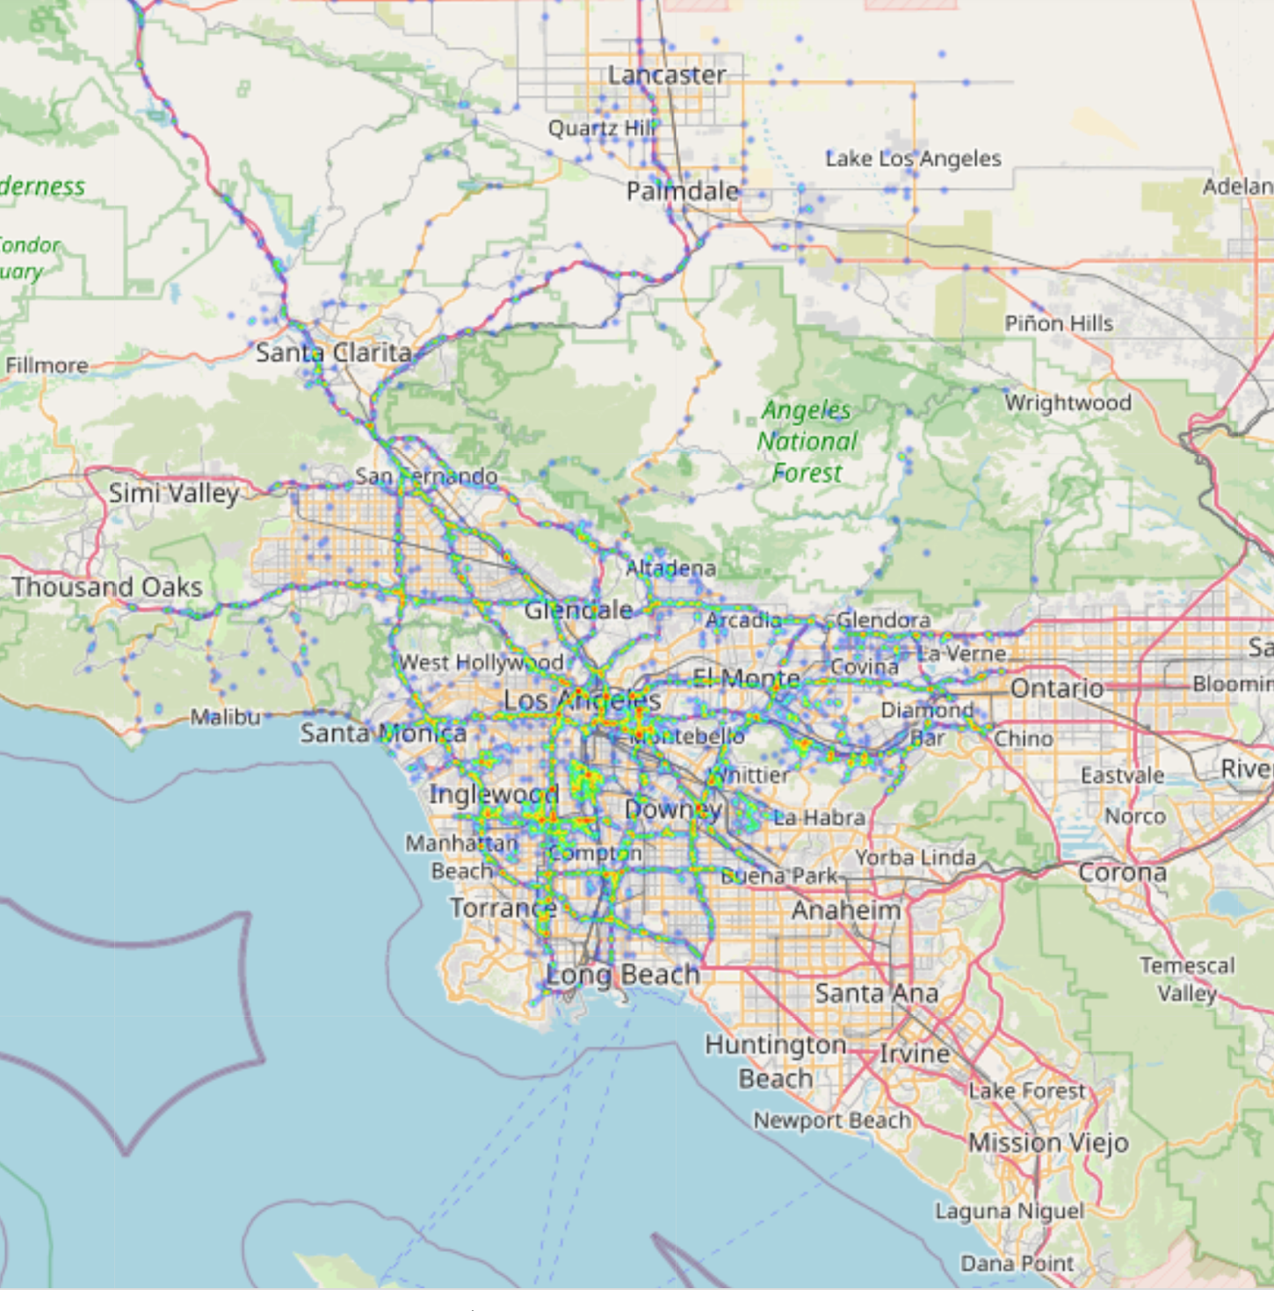
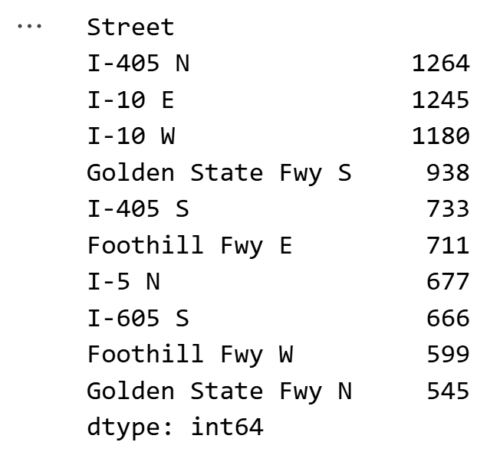
Drill down (City, Street)

Slide 11
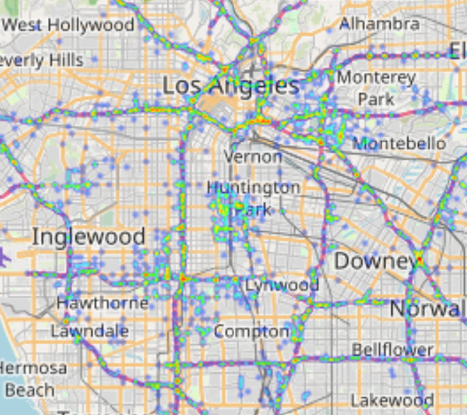
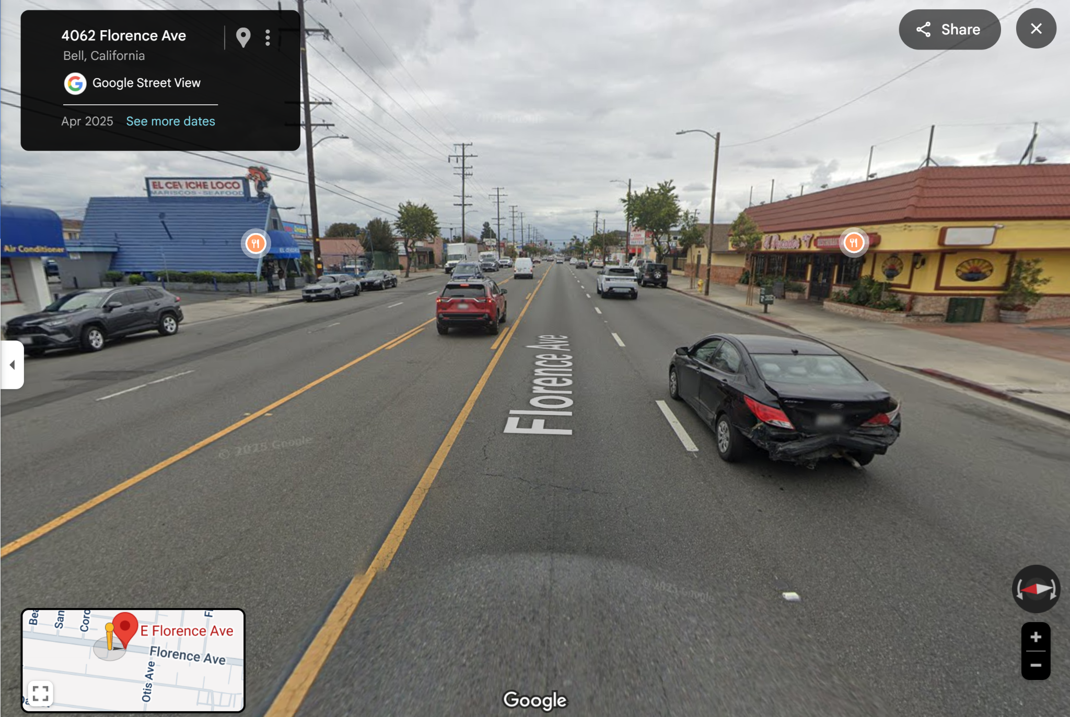
Interesting finding - Huntington Park
Graphs

Slide 12
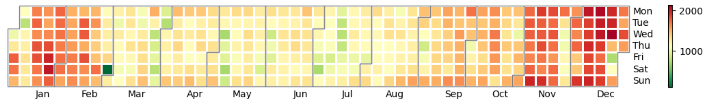
Solutions
Aggregate

Slide 13
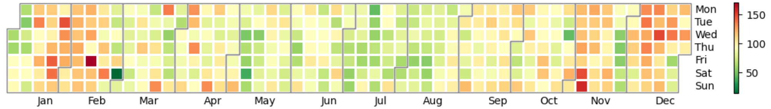
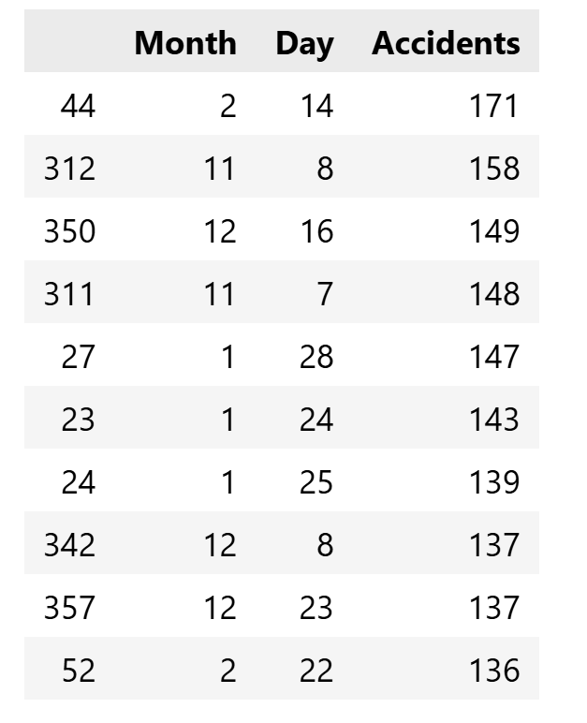
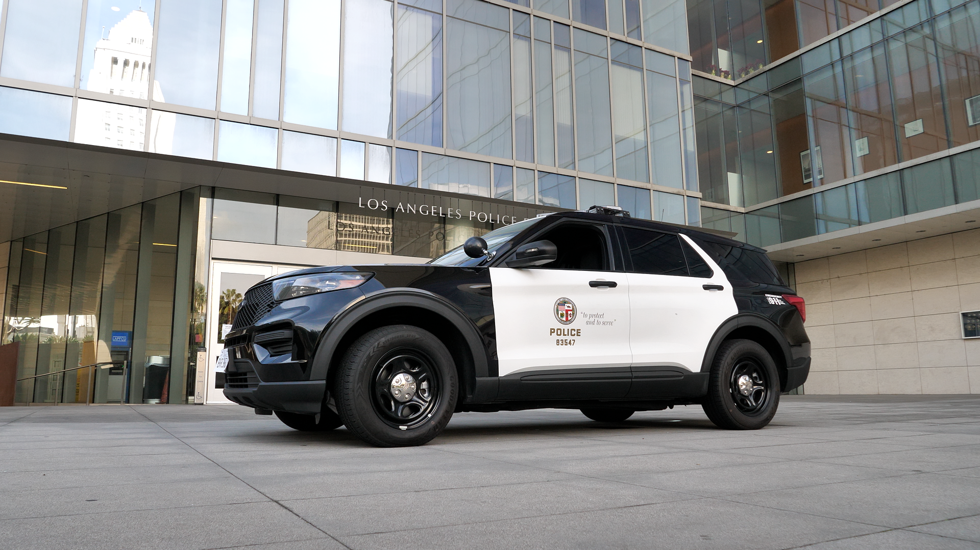
Solutions
LA

Slide 14


Additional Solutions
Improve infrastructure in accident-prone zones
Efficient allocation of resources for emergency services

Slide 15
Questions?

Slide 16
References
Centers for Disease Control and Prevention. (2024). Transportation safety: About. https://www.cdc.gov/transportation-safety/about/index.html
Insurance Institute for Highway Safety. (2024). Fatality facts: Yearly snapshot. https://www.iihs.org/research-areas/fatality-statistics/detail/yearly-snapshot
Moosavi, Sobhan, Mohammad Hossein Samavatian, Srinivasan Parthasarathy, and Rajiv Ramnath. “A Countrywide Traffic Accident Dataset.”, 2019.
Moosavi, Sobhan, Mohammad Hossein Samavatian, Srinivasan Parthasarathy, Radu Teodorescu, and Rajiv Ramnath. "Accident Risk Prediction based on Heterogeneous Sparse Data: New Dataset and Insights." In proceedings of the 27th ACM SIGSPATIAL International Conference on Advances in Geographic Information Systems, ACM, 2019.
National Highway Traffic Safety Administration. (2024). The economic and societal impact of motor vehicle crashes, 2019 (Report No. DOT HS 813 403). https://crashstats.nhtsa.dot.gov/Api/Public/ViewPublication/813403.pdf
Repairer Driven News. (2024, December 11). Report estimates fatal crashes cost U.S. $417 billion annually. https://www.repairerdrivennews.com/2024/12/11/report-estimates-fatal-crashes-cost-u-s-417-billion-annually

Slide 17
